Slide 1
CREAMING HONEY
Definitions and Processes
or
What, Why & How ?
______________
.

Slide 2
Introductions
Myself: Allen McCaw
Location: Milburn, South Otago.
Experience: -
45+ years in NZ Apicultural industry;
NBA National President: 1986 – ‘90; Chairman – NBA Marketing Committee:1992 – ’96; Trustee – NZ Honey Industry Charitable Trust - currently; 35 years Production Manager – Milburn Honey Ltd.
Qualifications: - B.Sc (Chem.);
Awards: Gold Medal winner NZ Honey Competition - Creamed Honey (Light) Section - 2010 to 2013, & 2015 to 2019;

Slide 3
Presentation Summary
  DEFINING “CREAMED HONEY”
  What is NOT creamed honey ?
  What IS creamed honey ?
  Why do we “cream” honey ?
  THE HONEY CREAMING PROCESS
  Principles of creaming honey (a bit of science)
  Practices in creaming honey (how to do it)
  Problems and remedies (if it all goes wrong !)

Slide 4
Defining
“Creamed Honey”
What is NOT creamed honey ?
“Granulated” honey
“Set” honey
“Candied” honey
“Whipped” honey
“Liquid” honey
“Runny” honey
“Raw” honey ( A definition for this type ??)

Slide 5
Defining
“Creamed Honey”
What IS creamed honey ?
(With appreciation to Peter Bray – www.airborne.co.nz)
  100% pure honey – nothing added (eg fat, icing sugar, flour)
  “Creaming” utilises and enhances natural granulation tendency of honey.
  Use of small crystal size (<25 microns) to seed honey creates smooth “mouth-feel” and “silky” appearance.
  Interlocking of fine crystals provides thick and spreadable properties.

Slide 6
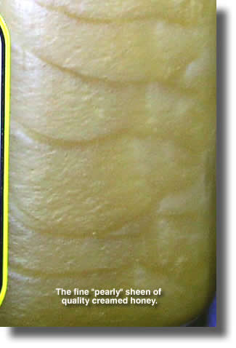
Defining
“Creamed Honey”
What IS Creamed Honey ?
  “Pearly” or “silky” appearance
  due to varying light reflection from
  small, flat crystals in honey –
  a mark of “quality” creamed honey.
(Photograph courtesy of Peter Bray –
Airborne Honey Ltd.)
Notes:
Tell you how we can achieve this result in each of our honeys.

Slide 7
Defining
“Creamed Honey”
Why do we cream our honey ?
    Primary Purpose: - Marketing and Product Sales.
      Increase consumption of honey;
      Better consumer experience (“mouthfeel”);
      Improved useable shelf-life;
      Product differentiation in overseas markets;
      Because WE can in NZ – and few others do in the world!
Notes:
INCREASED CONSUMPTION: High consumption per capita in NZ – estimated at 2kg per person per annum – “SPREAD IT ON THICKER” – especially children and men !
80% of honey sold in NZ in creamed form – rest as liquid or comb honey..
BETTER CONSUMER EXPERIENCE: Smooth mouthfeel –” not gritty”; – Easy to spread – stays on the bread or toast ;

Slide 8
1.The Honey Creaming Process
  Principles of creaming honey (a bit of science)
“Honey” is a generic name for a substance produced by honey bees from the nectar of flowers.
It is highly variable in composition, and changes naturally according to available nectar sources, natural habitat and climatic variations.
Natural honey is viscous (dense and sticky), and has a tendency to crystallize with temperature and moisture change.
Two major “sugars” in honey are glucose and fructose. (plus other minor, complex sugars eg oligosaccharides, sucrose, maltose)

Slide 9
Principles of creaming honey
Sugar content:- (glucose vs fructose)
Two main “sugars” in honey, affecting the creaming process.
Ratio/quantity of each determines rate of crystallization.
Higher glucose = faster crystallization = “good creaming”.
Higher fructose = slower crystallization = “poor creaming”.
NZ honey varietals vary across this scale.
Honey Blends may include both high and low level varieties.
Can create problems for creaming if varietals not known eg in blends of honey types from opposite ends of the scale.

Slide 10
Principles of creaming honey
Relative levels of Glucose and Fructose in Some
NZ Honey Varieties.
Rata Manuka/Kanuka Vipers Bugloss
Pohutakawa Ling Heather Tawari Nodding Thistle
Fuschia Kamahi. Blue Borage Rewarewa
Canola. Hieraciums. Clovers Honeydew
(Faster Crystallization) (Slower Crystallization)
HIGHER GLUCOSE HIGHER FRUCTOSE

Slide 11
Principles of creaming honey
Heating, Moisture and Viscocity:
Viscocity ( density of honey) is affected by temperature and moisture.
Important factors in creaming honey – influences rate of crystallizing, and final product appearance.
Moisture determined partly by bee foraging, partly by beekeeping practices, and partly by processing steps, eg. pumping and stirring.
Temperature important for “melting” honey, filtering or straining, and control is a key factor in the creaming process.

Slide 12
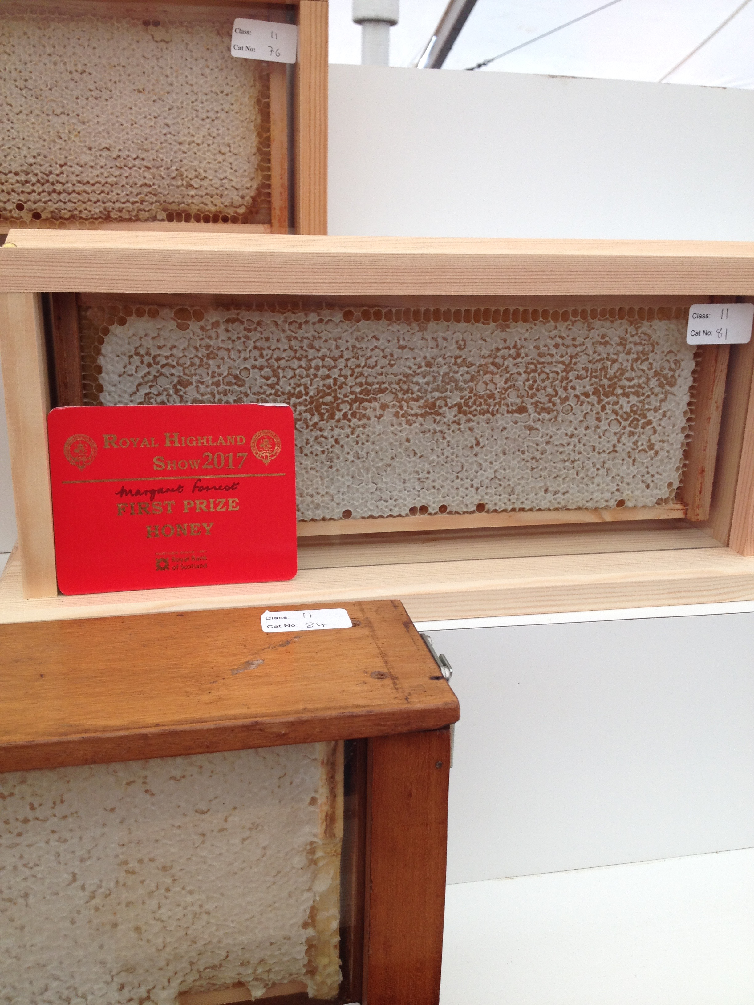
2. The Honey Creaming Process
Practices in Creaming Honey
How do we get from this…
To this….

Slide 13
The Honey Creaming Process
Practices in Creaming Honey – (how to do it !)
Points to ponder:-
Creaming honey is NOT a complicated process - unless you choose to make it that way (K.I.S.S. – “keep it simple !)
It IS a natural process – using the normal tendency for most honey types to crystallize naturally, BUT……….
Attention to detail and good control is essential for a good final product !!

Slide 14
Practices in Creaming Honey – (how to do it !)
The Three “T’s” of Good Honey Creaming
  TEMPERATURE
  TIME
  TENACITY

Slide 15
The Honey Creaming Process
The Creaming System: - “6-Step Process”
Dissolving crystallization – ‘Melting / Liquifying’
Straining - liquified honey – ‘Filtering’
Pre seeding cooling - strained honey
Seeding - cooled honey
Crystallizing – seeded honey – ‘controlled stirring’
Packing and storage (“setting”).
--------------------------------------------------------------------
Many variations in systems to achieve these steps – process essentially the same for all.
System used depends on need for capacity, and use of modern technology now available.

Slide 16
Practices in Creaming Honey – (how to do it !)
  TEMPERATURE CONTROL
  1) Dissolving/melting.
    Air or water heating? (Drum heating effect)
    40 to 65 °C ? (HMF – increases with length of heating time and temperature.)
    Modern heat exchangers and control systems – rapid heat and cool down.
    KEY OUTCOME = TOTALLY LIQUIFIED HONEY
  2) Filtering/straining.
    Gravity ? Pressure filter? (150 to 200 microns)
    Heat exchanger system.
    KEY OUTCOME = “CLEAN”, NATURAL HONEY

Slide 17
Practices in Creaming Honey – (how to do it !)
  3) Pre-seeding cooling :
    In-tank cooling or cold room ?
    Avoid moisture absorption from atmosphere – dehumidifier ?
    KEY OUTCOME = HONEY COOLED TO 12 to 15 °C BEFORE SEEDING WITH “STARTER” HONEY.
    4) Seeding of cooled honey:
    Fine-grained “starter” honey only - left in tank, or added?
    Preferably add cooled liquid honey to starter.
    Keep stirring while gradually adding liquid honey.
    KEY OUTCOME = FULLY HOMOGENISED, SEEDED MIXTURE

Slide 18
Practices in Creaming Honey – (how to do it !)
    Crystallizing / Creaming:-
      Can take time to complete - 2 to 3+ days ?
      Maintain cooling throughout creaming time – optimal temperature for creaming honey = 12 to 14 °C.
      Daily stirring – (approx 30 -60 minutes ?)
      Slow speed with effective mixing but gentle vortexing action – strong and fast agitation can be damaging to crystallization eg “whipped” honey = added moisture risk.
      Longer time for “softer” creamed honey – shorter time will produce “harder” creamed honey.
      KEY OUTCOME = FULLY-CREAMED HONEY, FINE-GRAINED, “SILKY” APPEARANCE, THICK CONSISTENCY BUT “MOTILE”.
      NOW YOU ARE READY TO PACK YOUR CREAMED HONEY !!

Slide 19
“Milburn Apiaries” Honey Creaming System
Based on a TWO DRUM batch size – ie up to 650 kg per pack.
Capacity of approx 50 tonnes per year.
Dual creaming / packing lines using two x 700 kg s/s creaming tanks
- one for bush types :- kamahi / manuka-kanuka / blends;
- one for pasture types:- white clover / clover blends.
Utilizes “pack & leave” creaming system – ‘starter’ honey retained in
creaming tanks between batches, approx 10% by weight.
Ambient temperature controlled by cooling units in creaming and
storage rooms ( + Mother Nature elsewhere –cooling NOT usually
a problem in South Otago !)

Slide 20
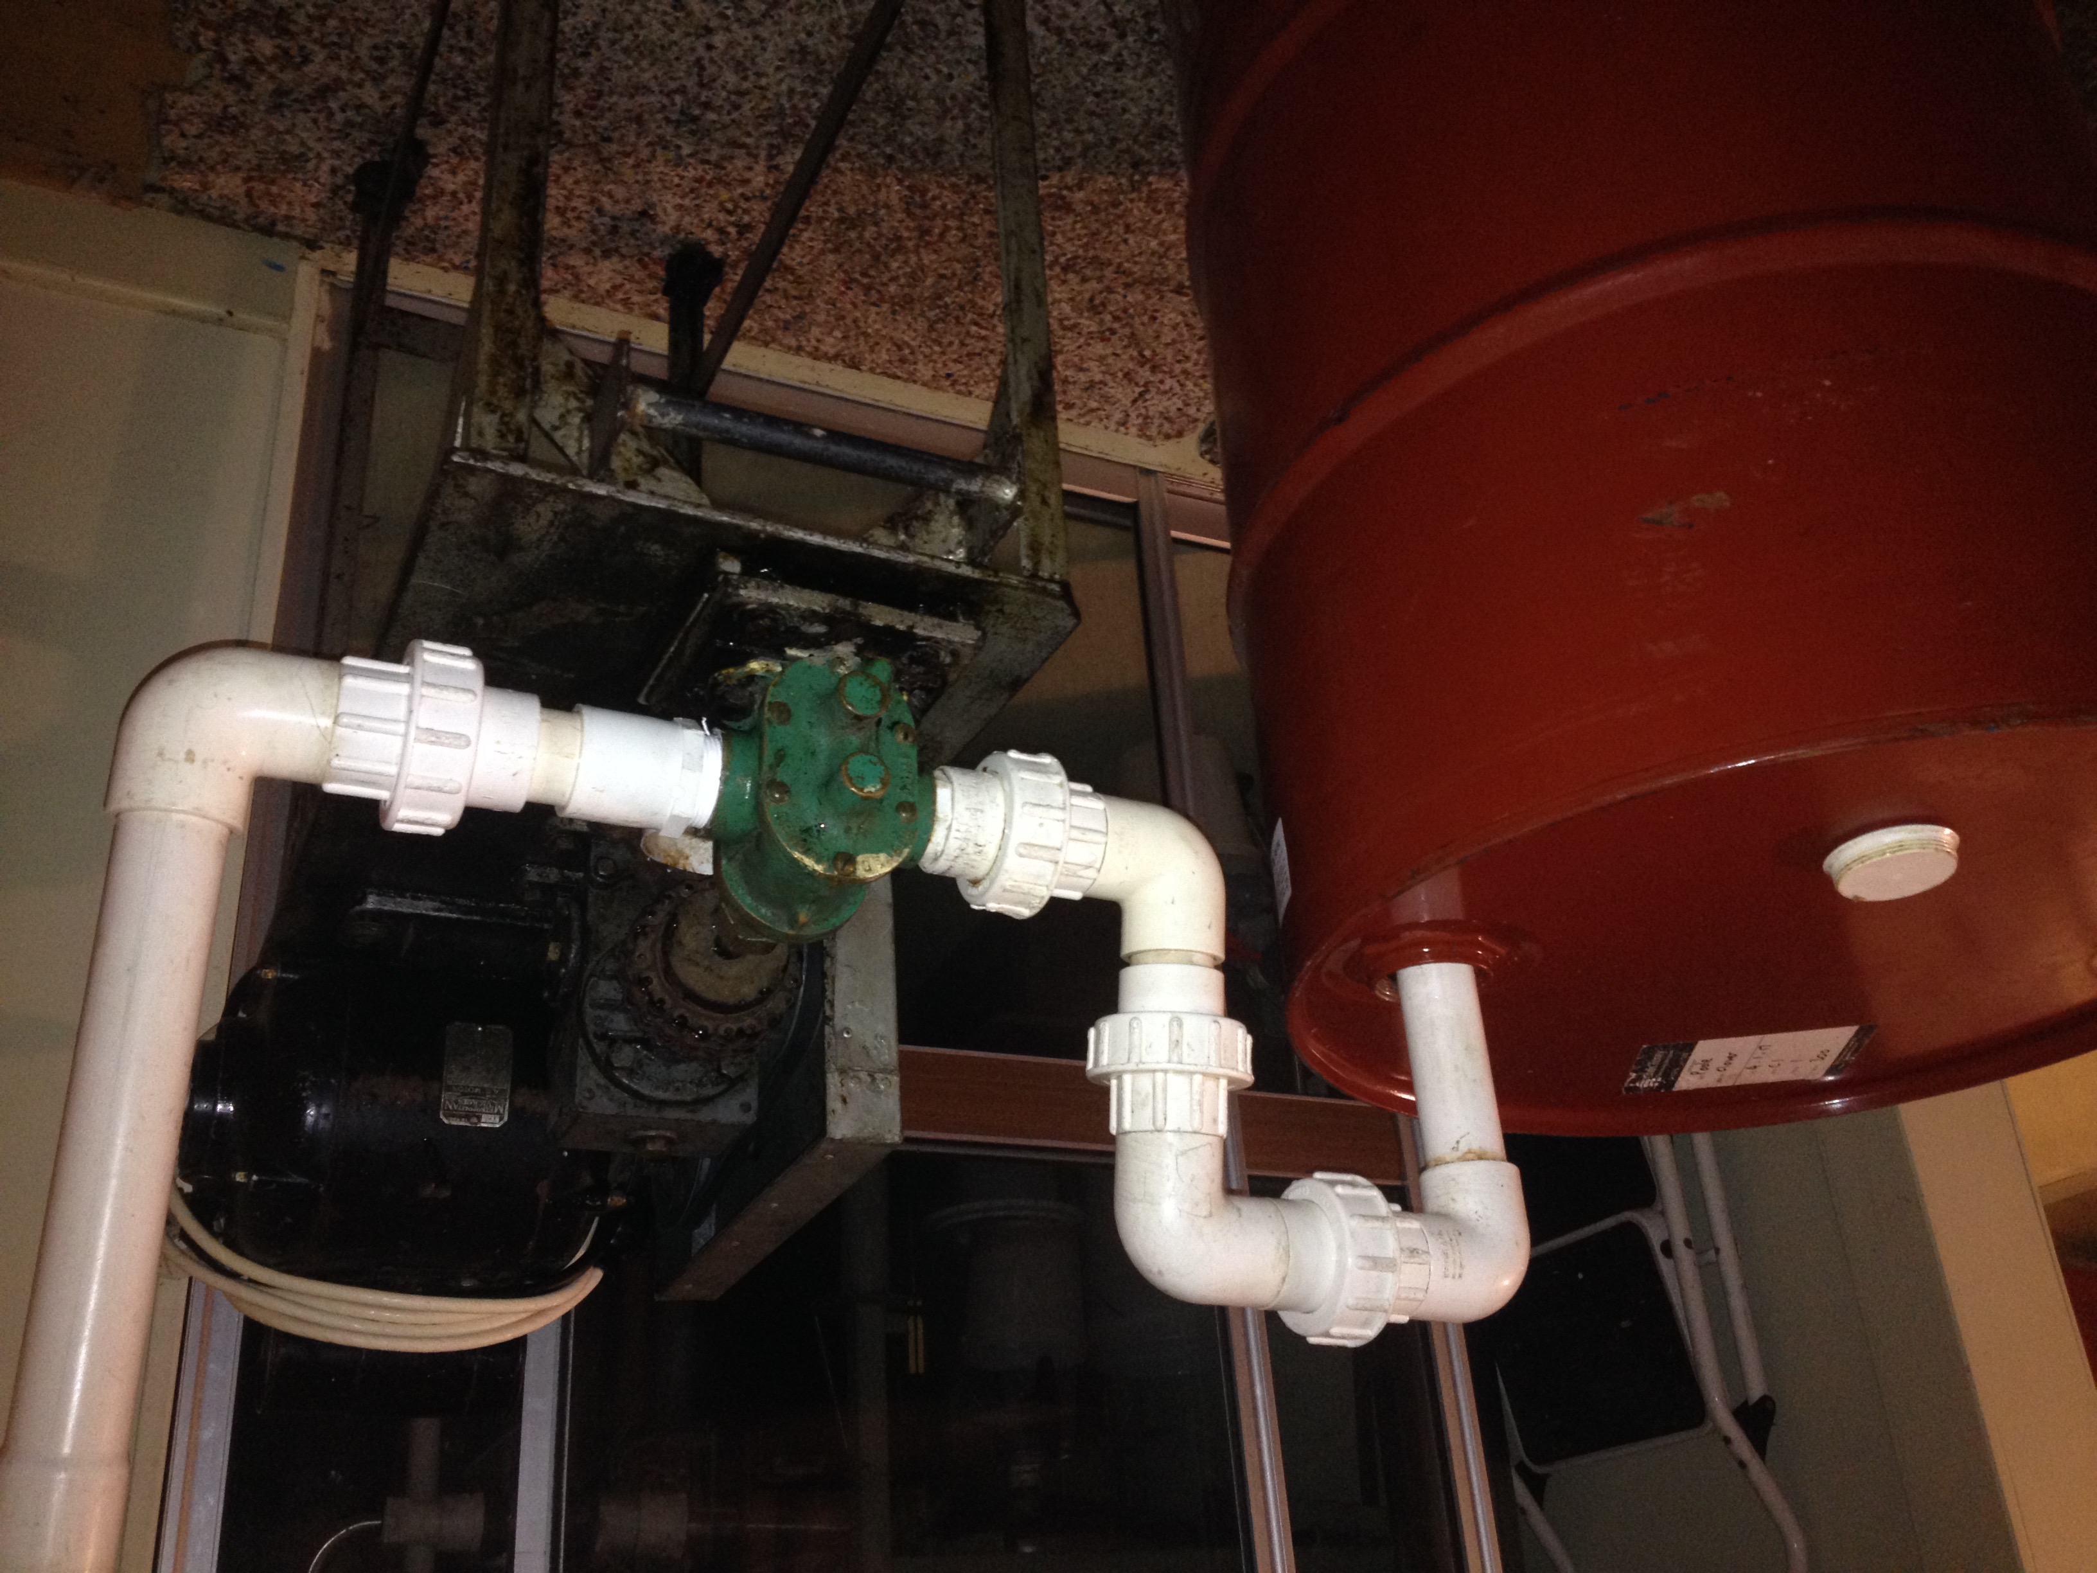
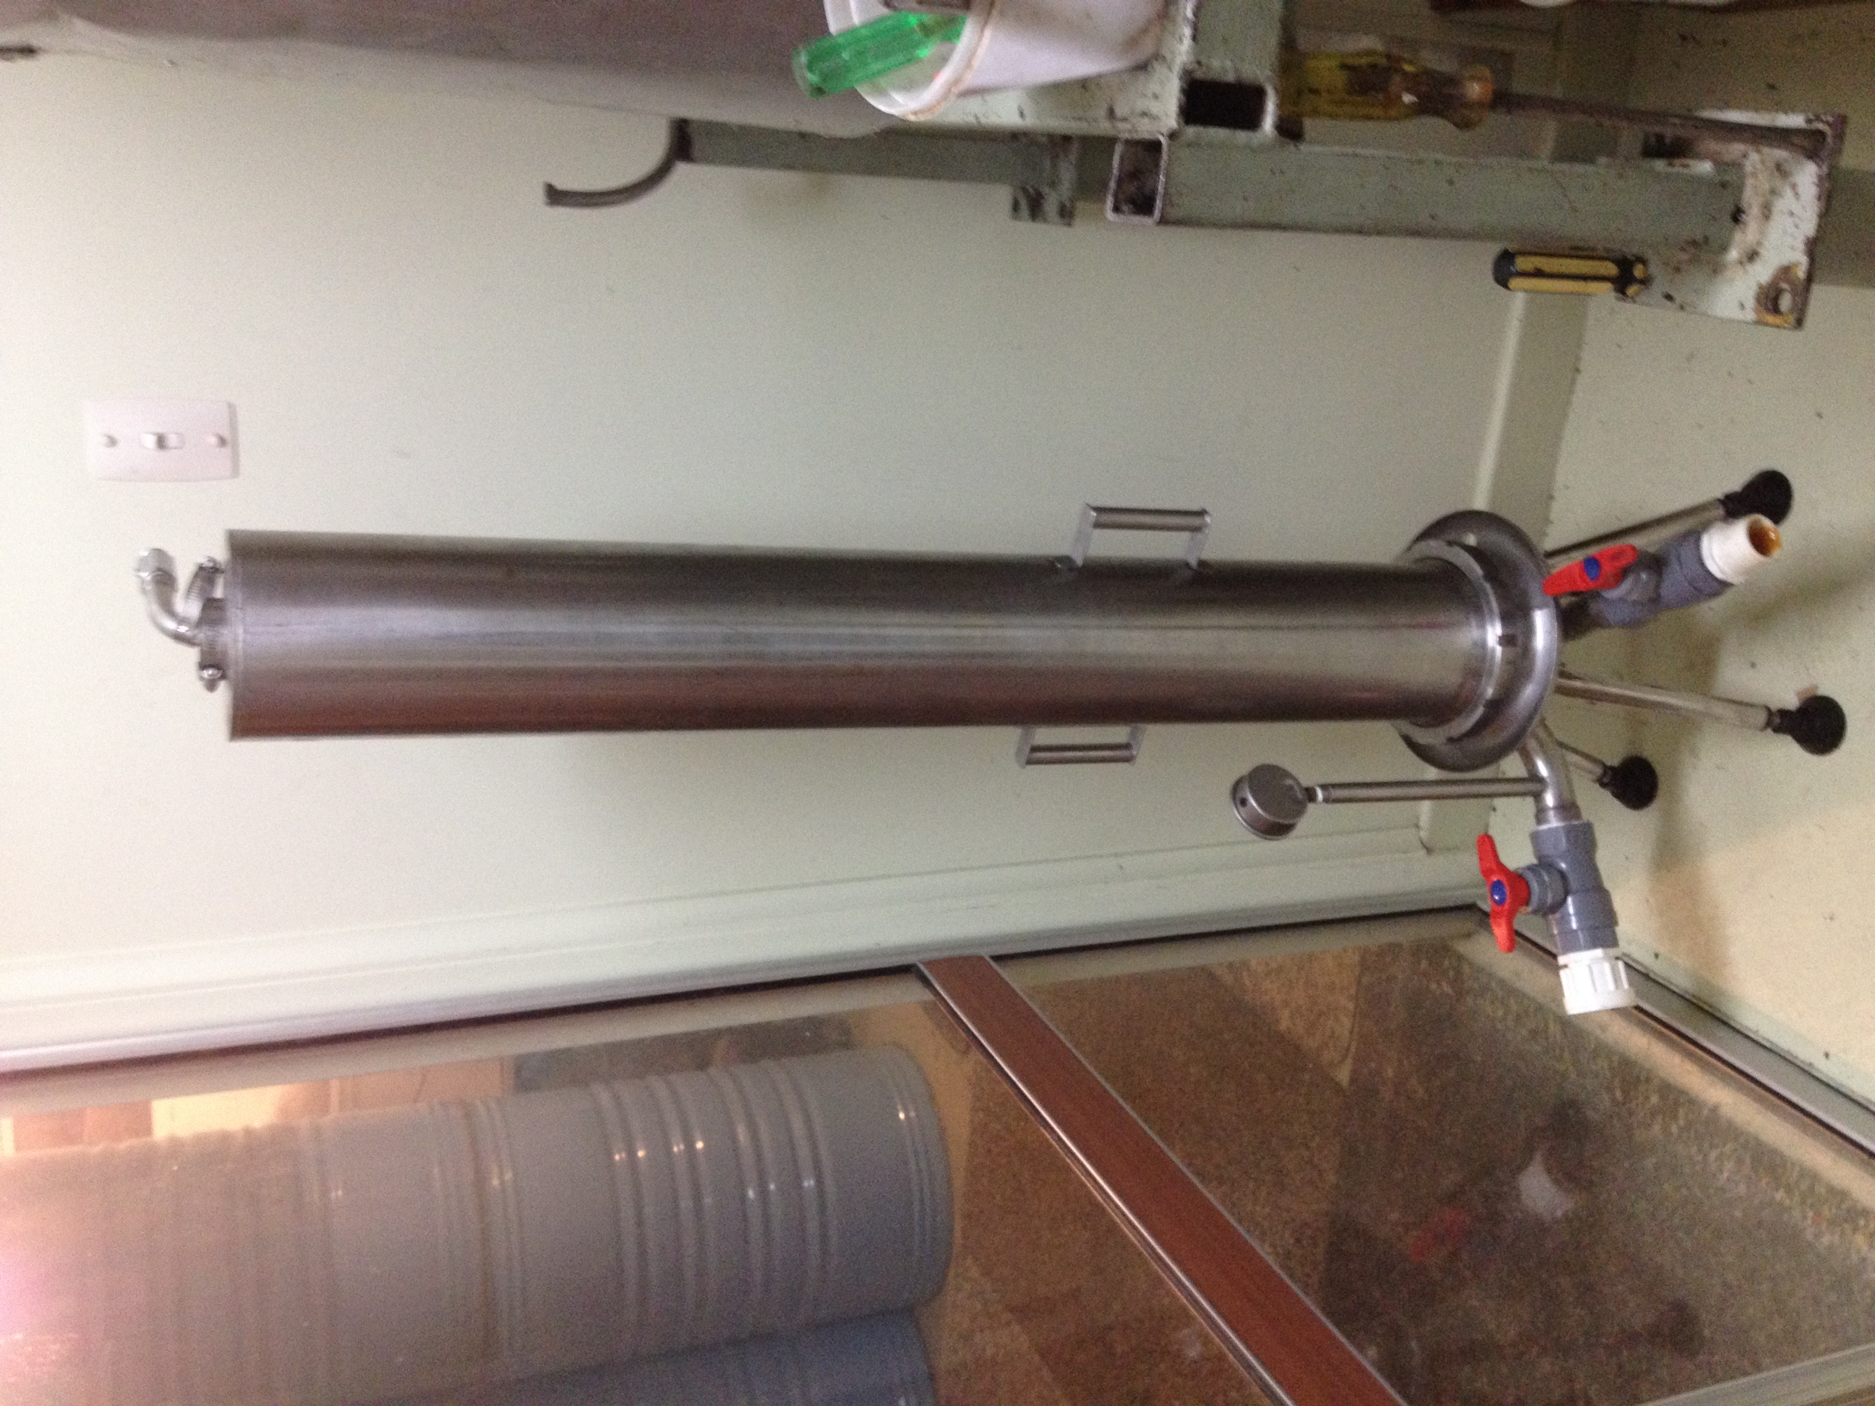
Milburn Apiaries” Honey Creaming System
Emptying “melted” drums
Straining / Filtering

Slide 21
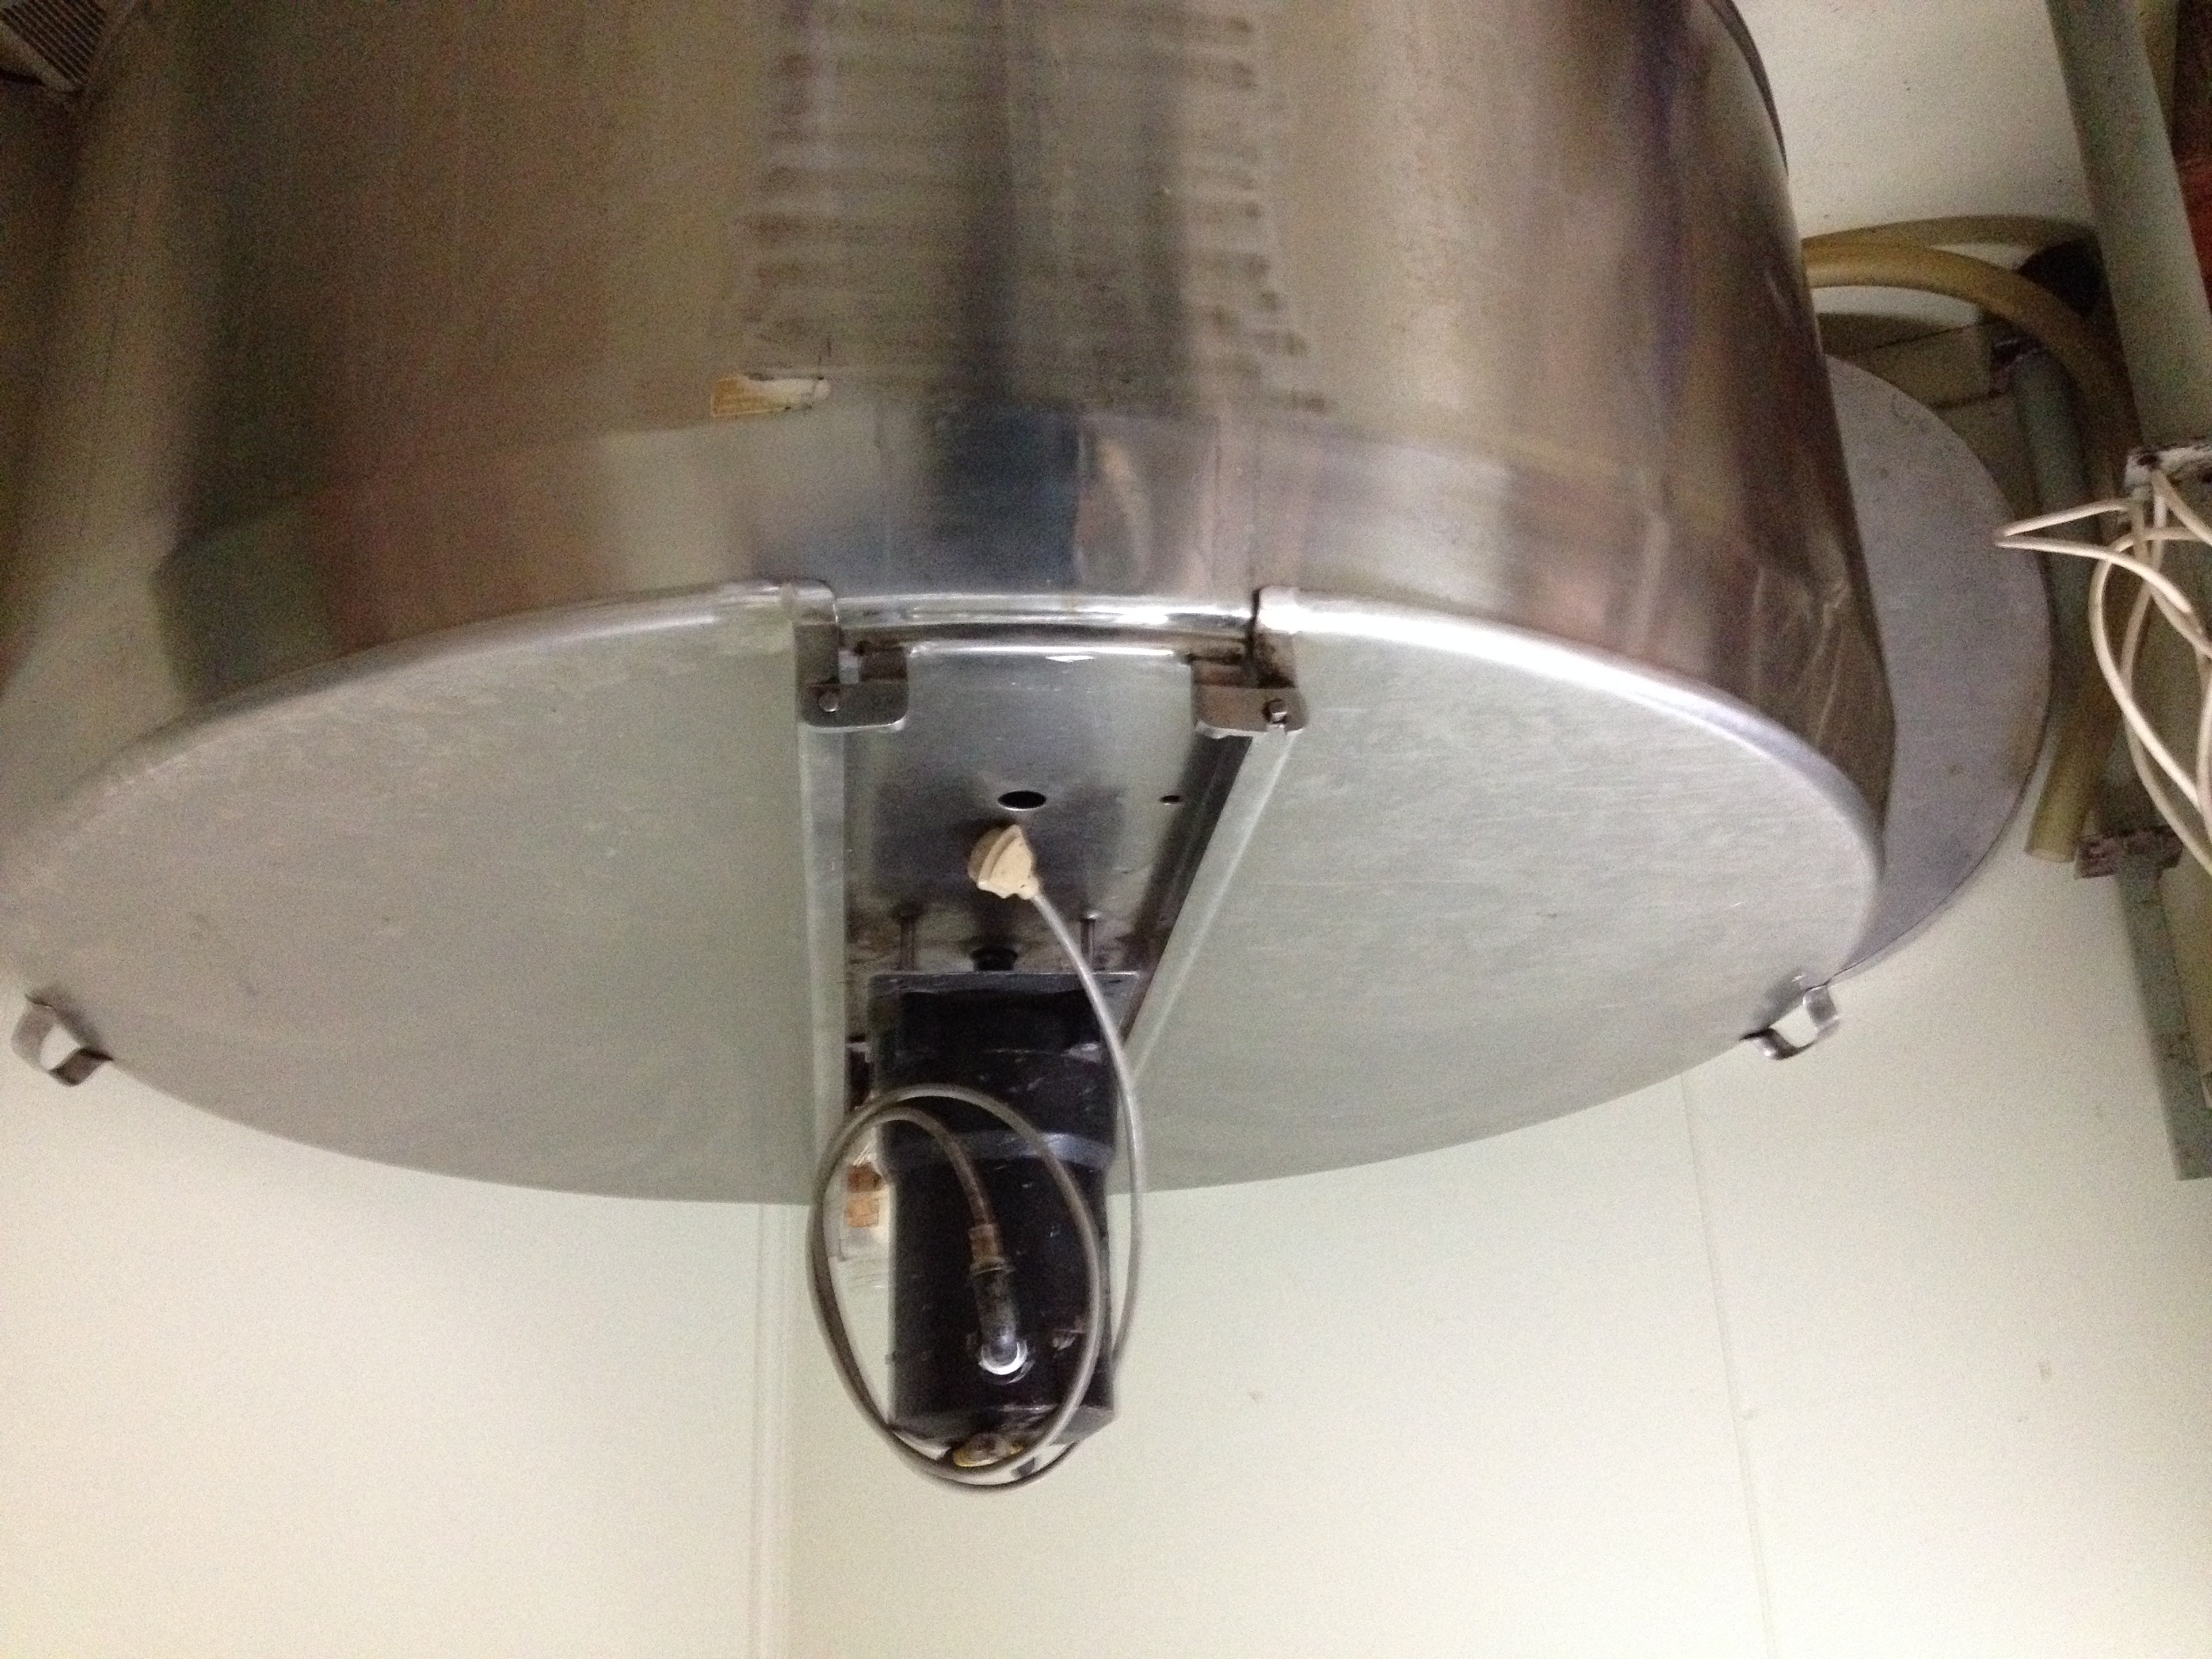
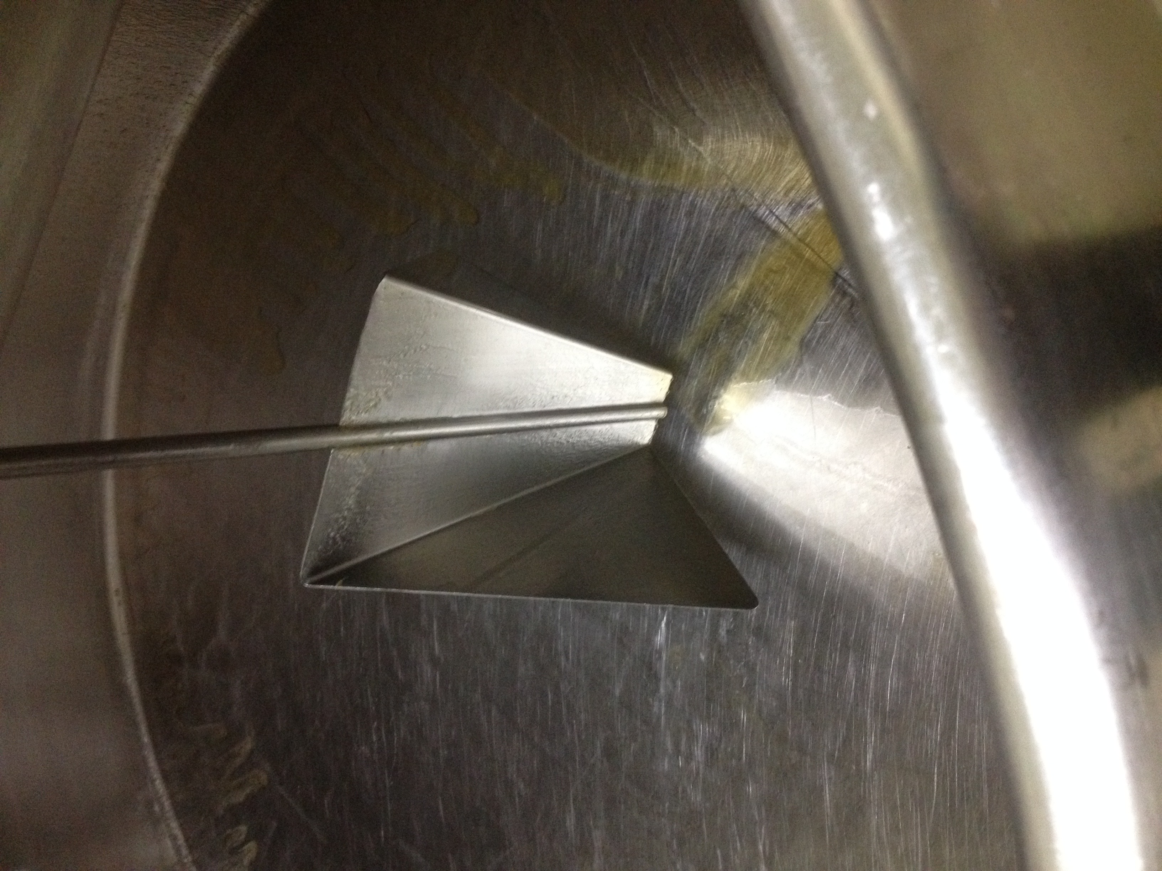
Milburn Apiaries” Honey Creaming System
Cooling / mixing tank
Cooling / mixing tank

Slide 22
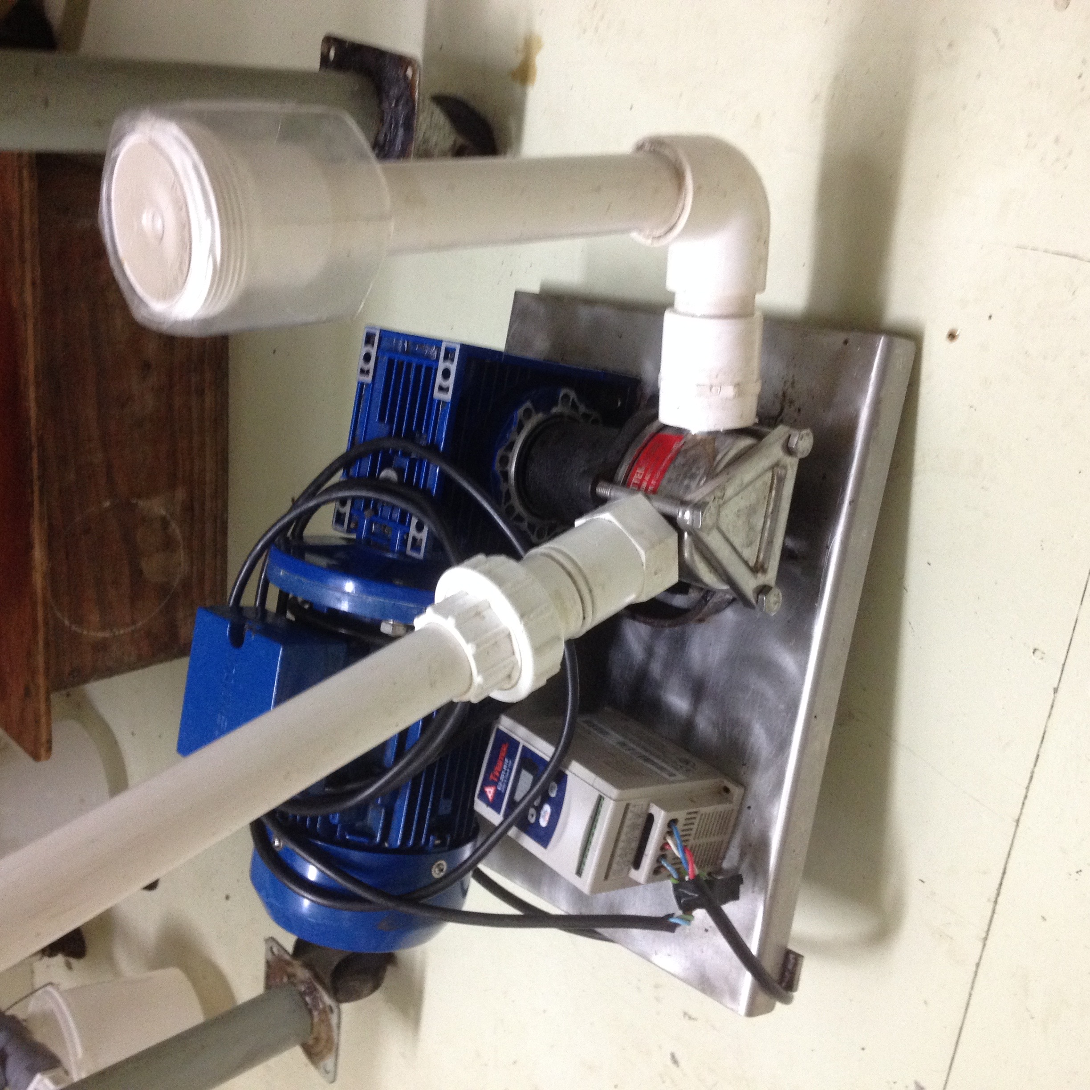
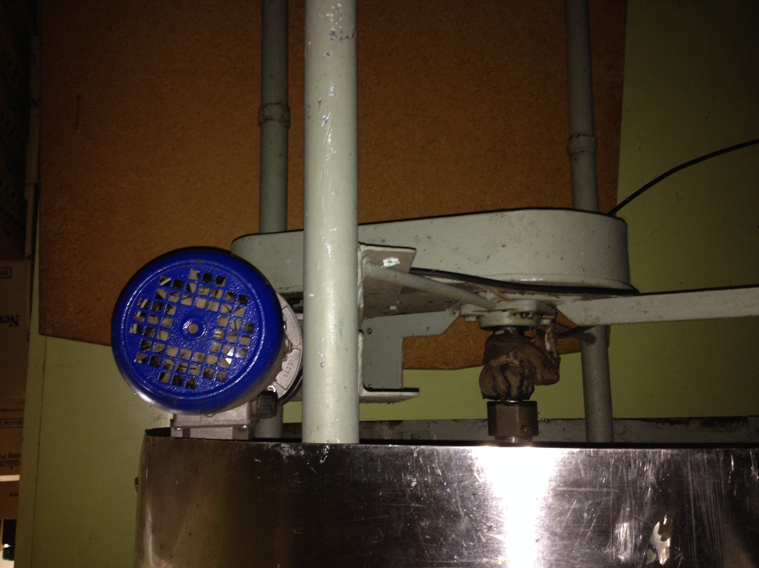
Milburn Apiaries” Honey Creaming System
“Cooled” honey pumping
Creaming tank with stirrer

Slide 23
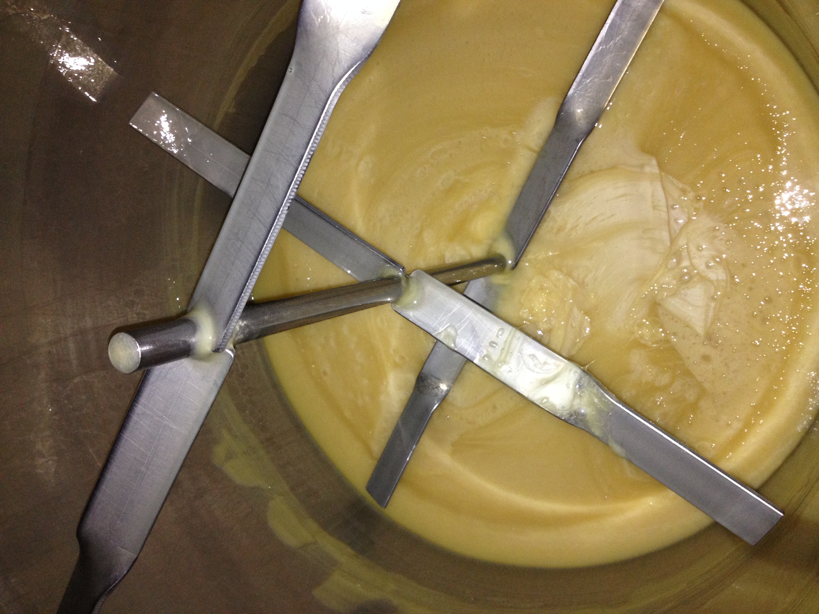
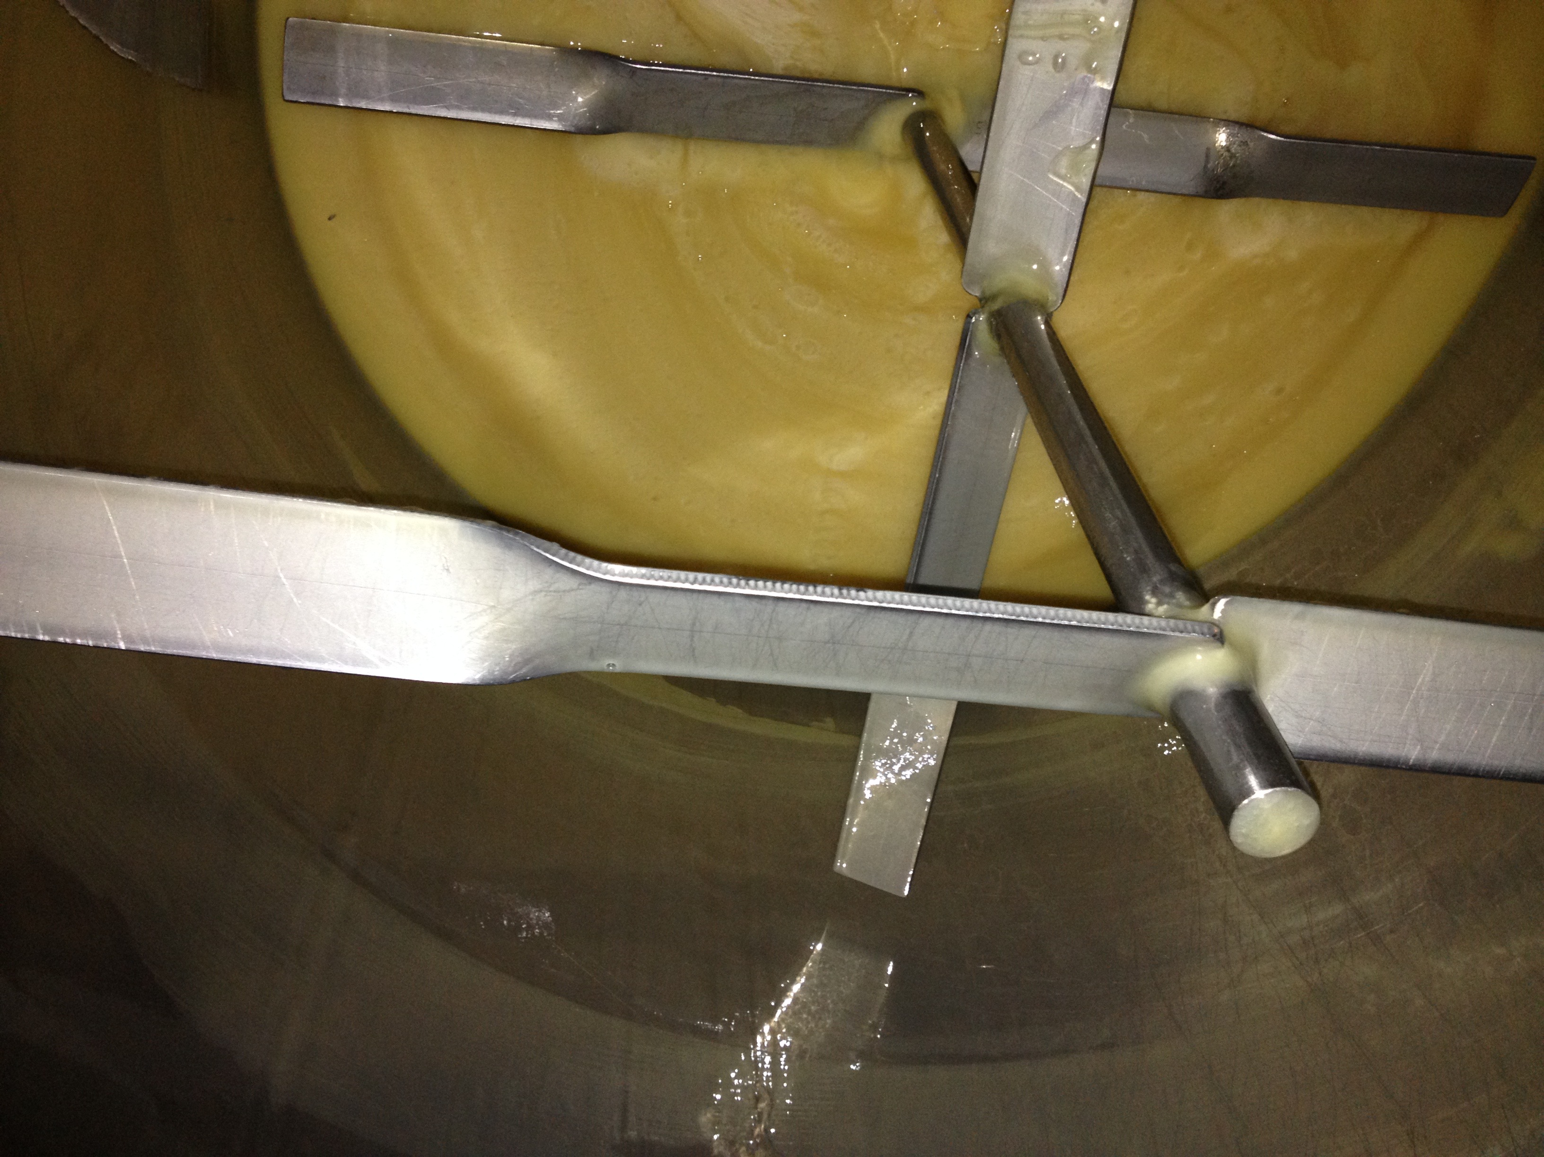
Milburn Apiaries” Honey Creaming System
Creaming Tank Stirrer
(“Starter” honey in bottom)
Creaming Tank Stirrer
(double twisted blades)

Slide 24
Practices in Creaming Honey – (how to do it !)
      6. Packing and Storage: (“setting” creamed honey)
      Crystallization will continue after packing.
      Final pack should be firm – but able to be “kneaded” – ie spreadable.
      Creamed honey best stored at temperatures below 18 to 20 °C .
      Can be “frozen” at -4 to -10 °C without losing overall quality.
      Temperate climates best suited to creamed honey in retail situation – partial melting and “layering” in jars is not attractive to consumers.
      Retailer and consumer education opportunity ?
      KEY OUTCOME = INCREASED HONEY SALES AND GREATER CUSTOMER SATISFACTION !!

Slide 25
  THE HONEY CREAMING PROCESS
Problems and Remedies:
What can go wrong ?
  Potential problems in every step of the creaming process.
  Usually can be remedied , but should not be ignored or brushed–off.
  If something does go wrong – fix it ASAP !
  If you don’t think you can fix it – ask someone for help !
  (most operators willing to discuss problems and offer suggestions from hard-earned experiences – but don’t expect to be supplied with “trade secrets”.)
  QUESTIONS, (AND ANSWERS) FROM OUR AUDIENCE ?

